Slide 1
Craft of Data Visualization
Interactive data visualization in Python
Alexey Zaytsev,
Skoltech, CDISE
15 January

Slide 2
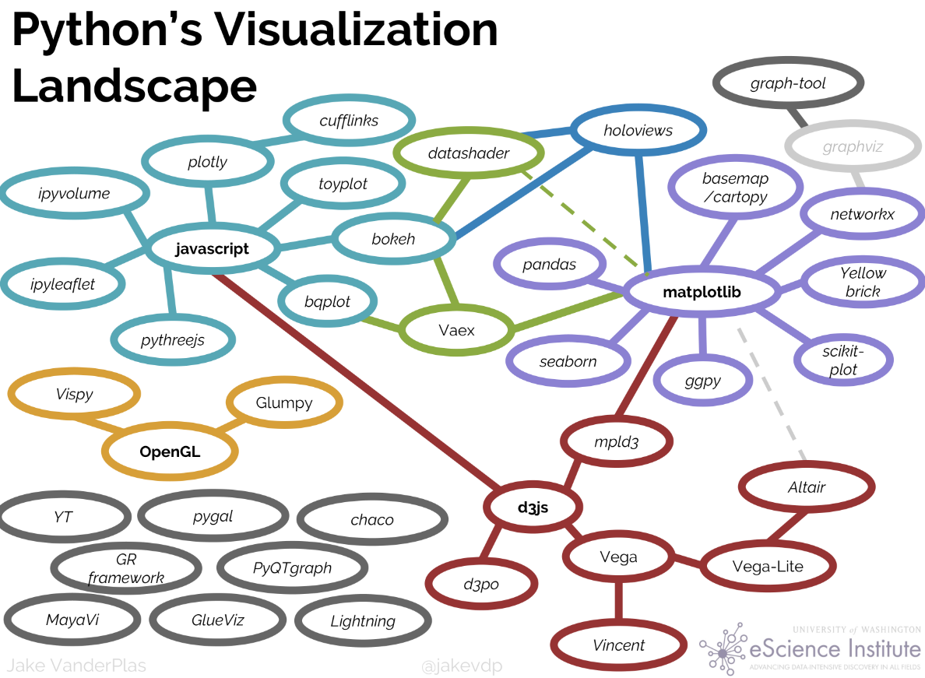
Python’s Data Visualization Landscape
Beyond Bullet Points, Cliff Atkinson
Jake VanderPlas, The Python Visualization Landscape PyCon 2017, https://www.youtube.com/watch?v=FytuB8nFHPQ

Slide 3
Python’s Data Visualization Landscape
Beyond Bullet Points, Cliff Atkinson
Jake VanderPlas, The Python Visualization Landscape PyCon 2017, https://www.youtube.com/watch?v=FytuB8nFHPQ

Slide 4
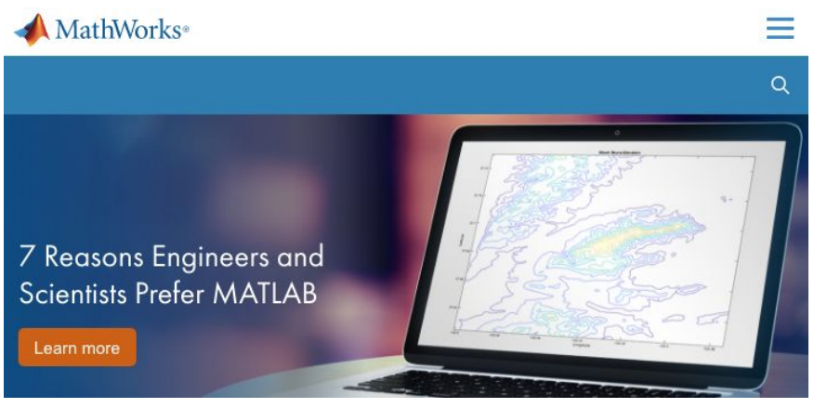
Plotting with Matplotlib
Strengths: - Designed like Matlab: switching was easy

Slide 5
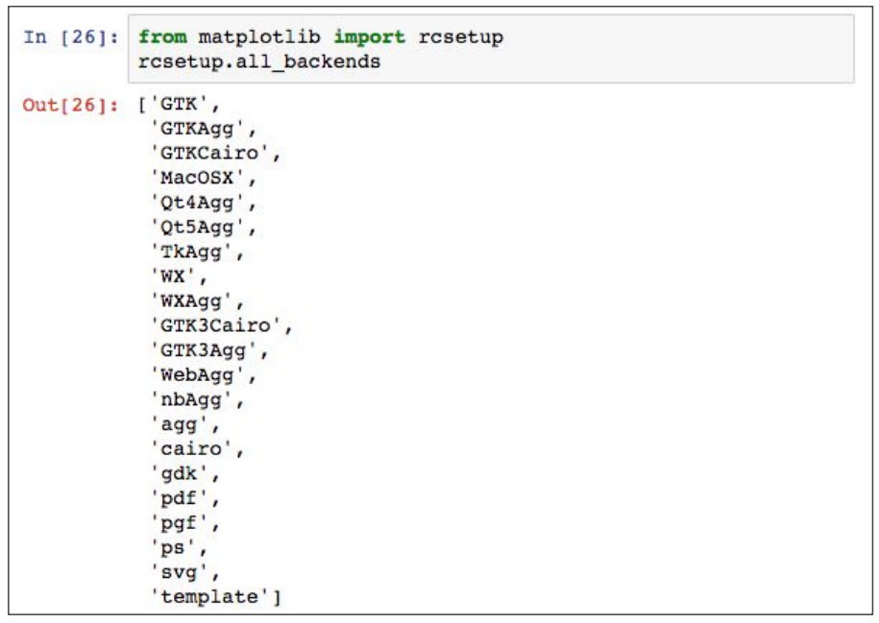
Plotting with Matplotlib
Strengths: - Designed like Matlab: switching was easy
- Many rendering backends

Slide 6
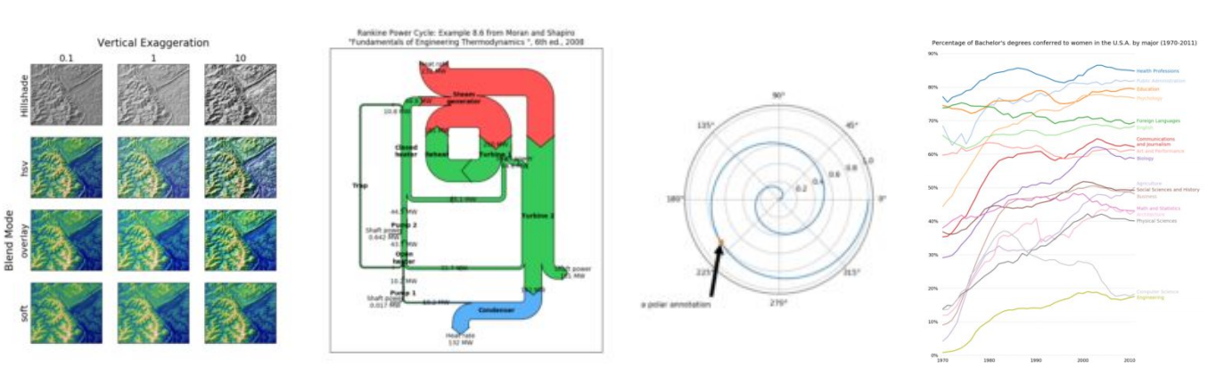
Plotting with Matplotlib
Strengths:
Designed like Matlab: switching was easy
Many rendering backends
Can reproduce just about any plot (with a bit of effort)

Slide 7
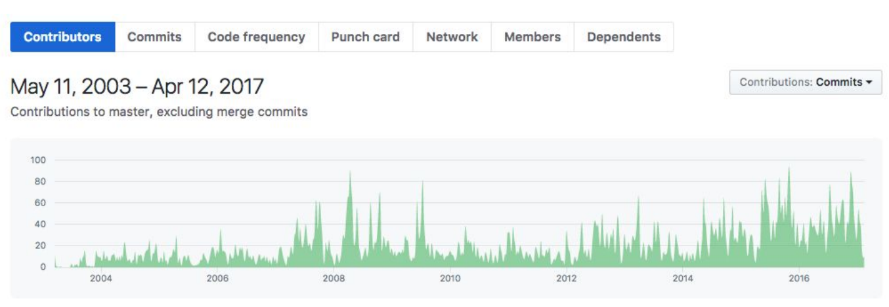
Plotting with Matplotlib
Strengths:
Designed like Matlab: switching was easy
Many rendering backends
Can reproduce just about any plot (with a bit of effort)
Well-tested, standard tool for over a decade

Slide 8
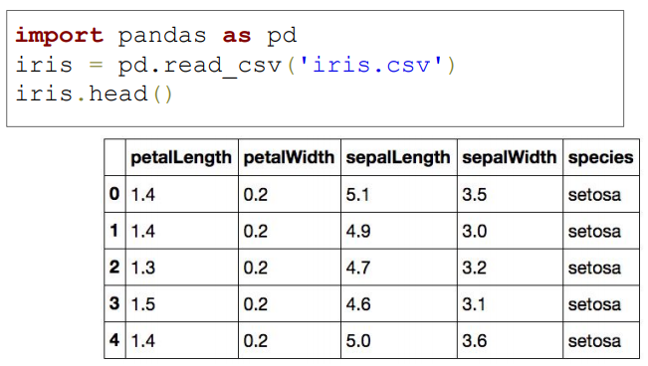
It can be too complex sometimes!
Example: Iris Data

Slide 9
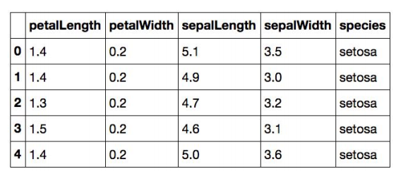
It can be too complex sometimes!
“I want to scatter petal length vs. sepal length, and color by species”

Slide 10
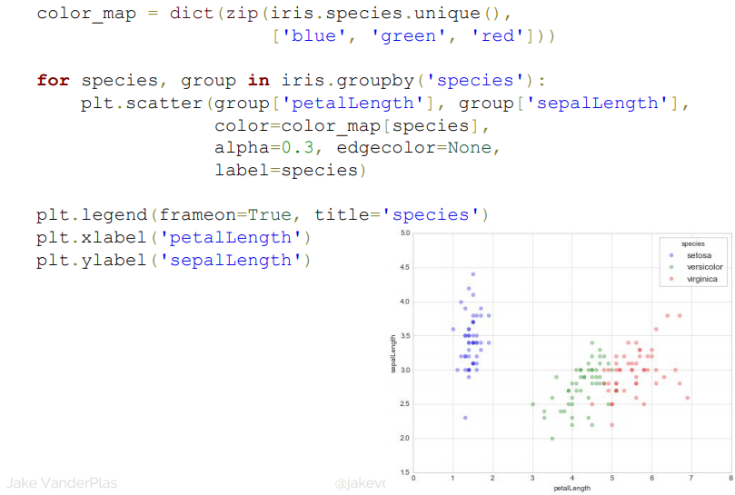
It can be too complex sometimes!

Slide 11
Plotting with Matplotlib
Strengths:
Designed like Matlab: switching was easy
Many rendering backends
Can reproduce just about any plot (with a bit of effort)
Well-tested, standard tool for over a decade
Weaknesses:
API is imperative & often overly verbose
Sometimes poor stylistic defaults
Poor support for web/interactive graphs
Often slow for large & complicated data

Slide 12
Everyone’s Goal: Improve on the weaknesses of matplotlib (without sacrificing the strengths!)

Slide 13
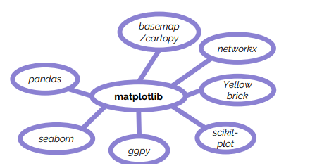
Building on Matplotlib
Common Idea: Keep matplotlib as a versatile, well-tested backend, and provide a new domain-specific API.

Slide 14
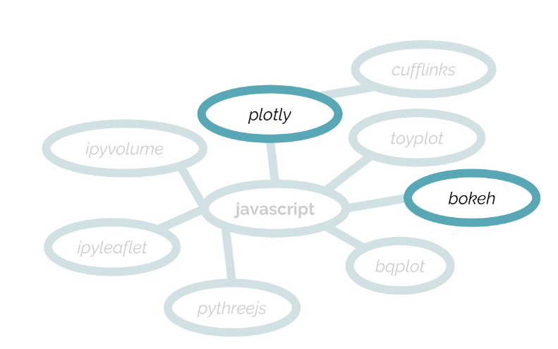
Javascript based Viz
Common Idea: build a new API that produces a plot serialization (often JSON) that can be displayed in the browser (often in Jupyter notebooks)

Slide 15
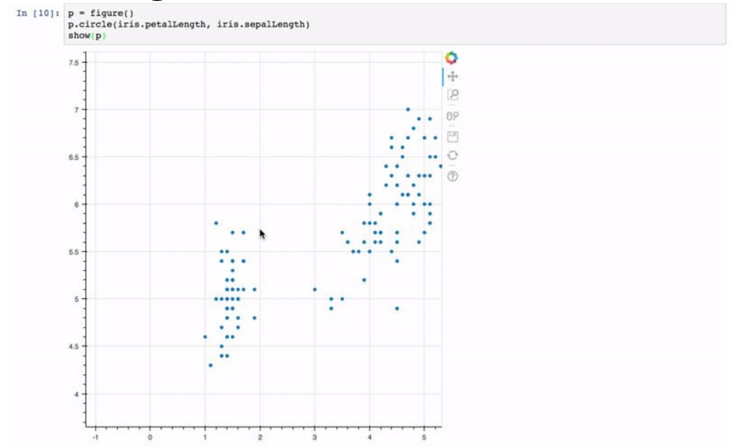
Plotting with Bokeh

Slide 16
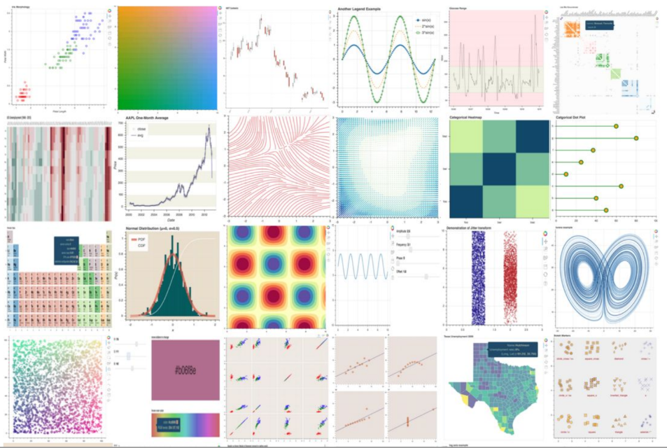
Bokeh gallery

Slide 17
Plotting with Bokeh
Strengths:
Web view/interactivity
Imperative and Declarative layer
Handles large and/or streaming datasets
Geographical visualization
Fully open source
Weaknesses:
No vector output (need PDF/EPS? Sorry)
Newer tool with a smaller user-base than matplotlib
Slow for large data

Slide 18
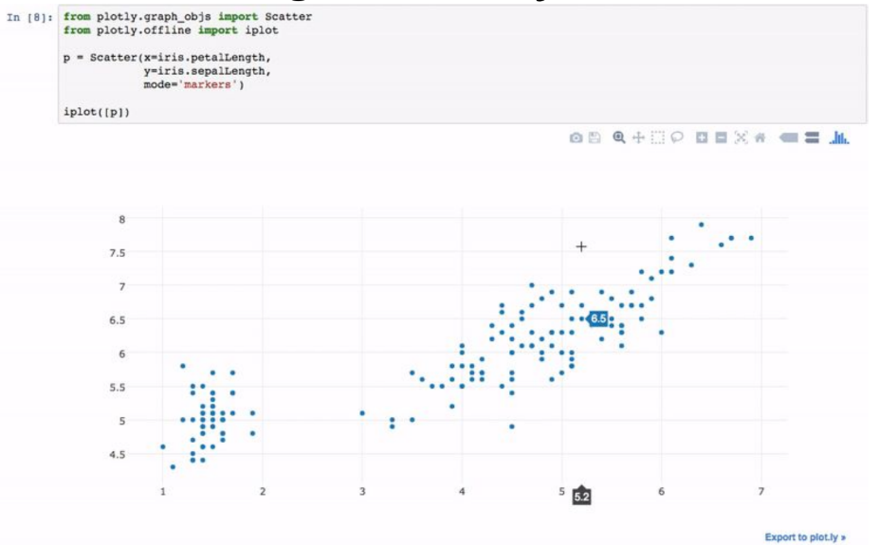
Plotting with Plotly

Slide 19
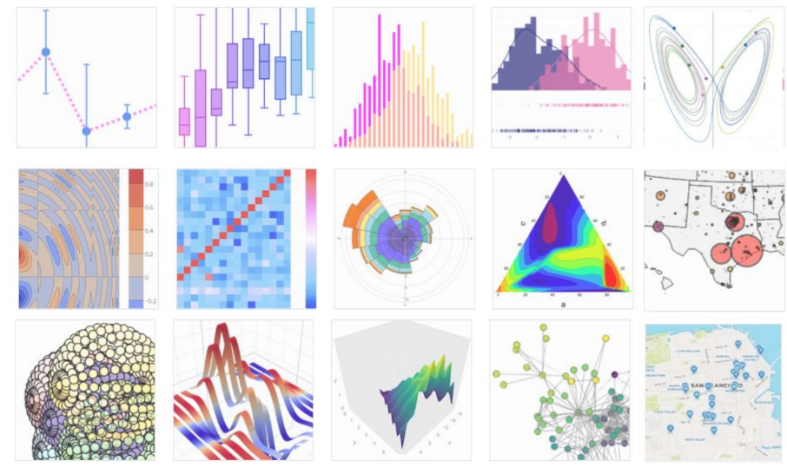
Plotly gallery

Slide 20
Plotting with Plotly
Strengths:
Web view/interactivity
Multi-language support
3D plotting capability
Animation capability
Geographical visualization
Weaknesses:
Some features require a paid plan

Slide 21
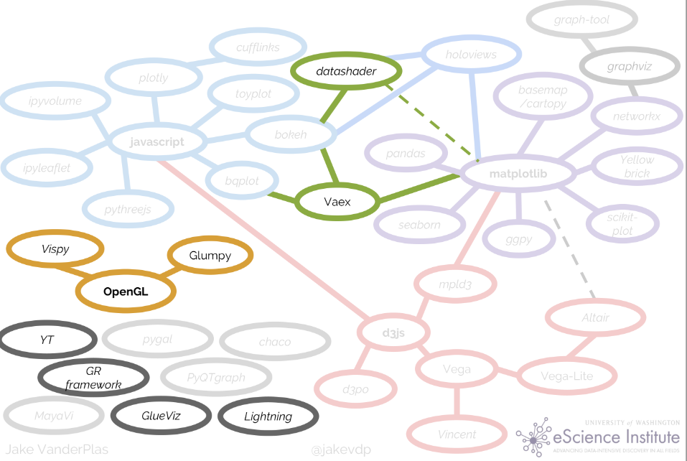
Visualization of Larger data
Jake VanderPlas, The Python Visualization Landscape PyCon 2017, https://www.youtube.com/watch?v=FytuB8nFHPQ

Slide 22
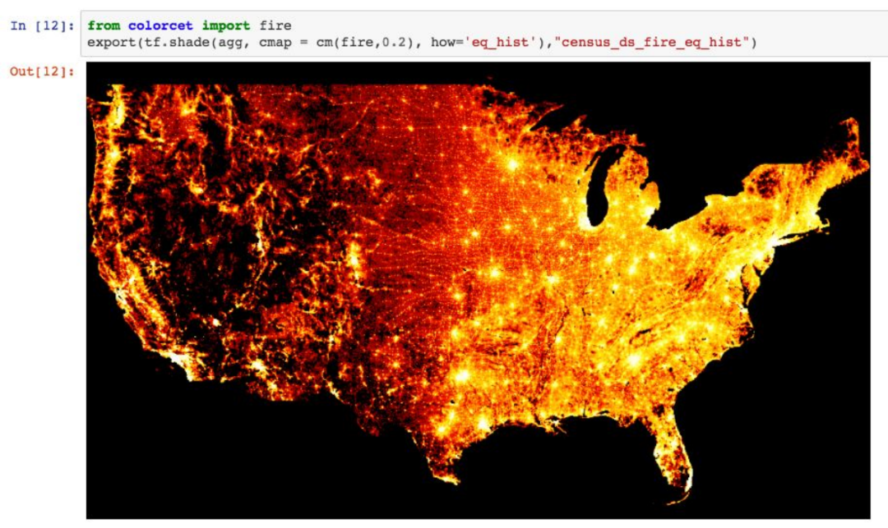
Datashader example
Fast server-side engine for dynamic data aggregation

Slide 23
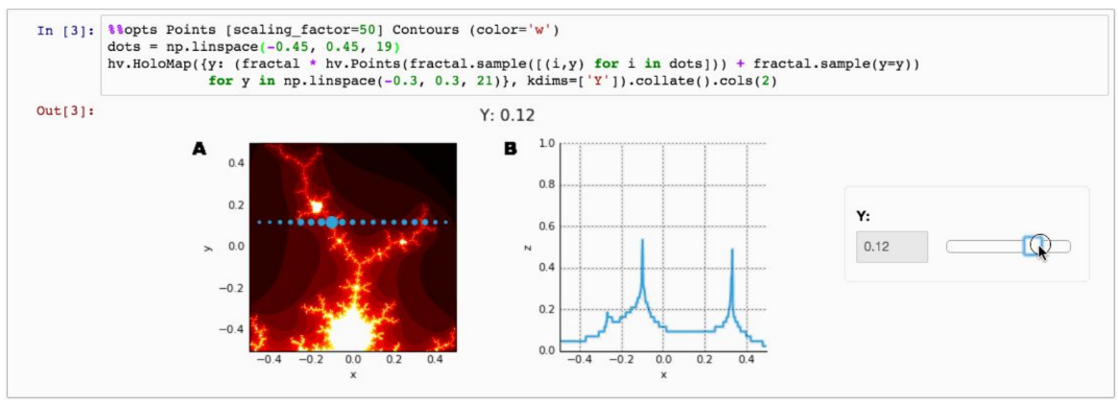
Holoviews
Datasets themselves stored in objects that automatically produce intelligent visualizations
Composition & Interactivity via operator overloading
Renders to Bokeh, DataShader, and Matplotlib

Slide 24
Let’s have a look at Bokeh
https://hub.mybinder.org/user/bokeh-bokeh-notebooks-lr6k0kge/notebooks/tutorial

